Slide 1

A Transformer Based Short Term Spectrum Prediction for Wireless Medium Access
Md Nafis Faiyaz, 180041101
Md Farhan Ishmam, 180041120
Nejd Khadija, 180041153
Computer Science and Engineering
Islamic University of Technology
Gazipur, Bangladesh
12 May, 2022

Slide 2
Introduction
Everyday the number of connected devices dependent on wireless environment is growing and as a result spectrum scarcity has become a fearsome challenge for today and tomorrow.
Successfully predicting future spectrum can result in substantial reduction of time and energy consumption. Users will only need to sense the channels whose probability to stay idle in next time slot is high enough.
Existing collision avoidance techniques mostly apply handcrafted algorithms. Therefore application of recent machine learning and deep learning techniques has great potential to significantly improve the current state-of-the-art spectrum predictions.
Our research will improve the solution to this problem by implementing a new ML algorithm i.e. Transformers.

Slide 3
Related Work: Overview
Neural Network
A neural-network-based MF-TDMA MAC scheduler for collaborative wireless networks. [1]
Deep Learning for Spectrum Prediction From Spatial–Temporal–Spectral Data. [2]
A neural network prediction based adaptive mode selection scheme in full-duplex cognitive networks. [3]
Reinforcement Learning
Multi-Agent Deep Learning for Multi-Channel Access in Slotted Wireless Networks. [4]
Long Short Term Memory
Convolutional LSTM-based Long-Term Spectrum Prediction for Dynamic Spectrum Access. [5]
Spectrum prediction via long short term memory. [6]
Convolutional Neural Network
Deep learning-based spectrum prediction collision avoidance for hybrid wireless environments. [7]

Slide 4
A neural-network-based MF-TDMA MAC scheduler for collaborative wireless networks [1]
Problem Domain: Wireless Spectrum Resource Scarcity, Multi-Technology Challenges
Problem Specification: Increased collision because of Cross-technology Interference Effects due to same spectrum wireless transmission among different technologies (e.g., WiFi, Bluetooth)
Proposed Solution: Function approximation to accurately predict free slots in Multiple Frequency Time Division Multiple Access (MF-TDMA) network using Neural Networks (NNs).
Mechanism: Observe the spectrum and perform online learning using NNs to predict the behaviour of the spectrum a second in advance.
Results:
Reduction of collision by half over traffic generated following a Poisson distribution
Reduction of collision by a factor of 15 over traffic generated from a periodic traffic pattern

Slide 5
Deep Learning for Spectrum Prediction From Spatial–Temporal–Spectral Data [2]
Problem Domain: Spectrum Prediction
Challenges: Complex inherent dependency, Heterogeneity among spectrum data
Previous Models: Models based on Linear Regression, Bayesian Inference, and Matrix/Tensor completion
Proposed Solution: Spatial Temporal Spectral Prediction Network (STS-PredNet) which is an End-to-end deep learning based model to collectively predict the states of various frequency bands in all locations of interest at the same time.
Improvements: Significant reduced spectrum prediction error on four evaluation metrics: mean absolute percentage error (MAPE), mean absolute error (MAE), root mean square error (RMSE), and R-squared error (R²)

Slide 6
A neural network prediction based adaptive mode selection scheme in full-duplex cognitive networks [3]
Problem Domain: Wireless Spectrum Resource Scarcity, Full-Duplex networks
Existing Technology:
Cognitive Radio Networks (CRNs) using Dynamic Spectrum Access (DSA)
Full-Duplex (FD) communications using two modes: transmission-and-reception (TR) and transmission-and-sensing (TS) mode
Limitations of Existing Technology: In FD communication, there’s a trade-off between higher throughput due to simultaneous transmission in TR mode and lower collision probability in TS mode.
Proposed Solution: Adaptive mode selection based on secondary user’s belief of the idleness of primary user using probability of primary user’s return which is calculated using Neural Networks (NNs).

Slide 7
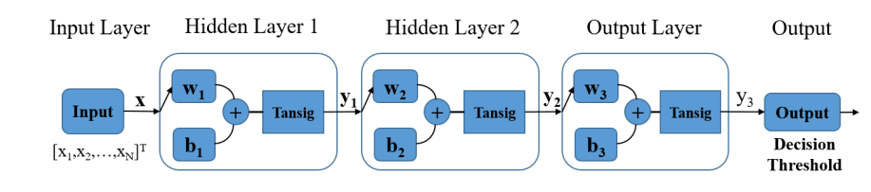
A neural network prediction based adaptive mode selection scheme in full-duplex cognitive networks [3] (cont.)
NN Architecture:
Results: Achieved almost same average throughput in TR mode and reduced collision probability by up to 92% compared to conventional TR mode.

Slide 8
Multi-Agent Deep Learning for Multi-Channel Access in Slotted Wireless Networks [4]
Problem Domain: Wireless Spectrum Resource Scarcity, Multi-Technology Challenges
Existing Technology: Collision avoidance technique are used to deal with this problem. They are:
Random-backoff when Spectrum Collision is detected
Assume knowledge about other nodes’ spectrum occupation
Limitations of Existing Technology: Fails to optimize overall channel capacity and throughput of all neighboring wireless networks.
Proposed Solution: Using a Deep Neural Network (DNN) to predict spectrum occupation of unknown neighboring networks in the future by using online supervised learning in a multi-agent setting.
Improvement:
Reduction in collision rate the network with its neighboring networks by 30%
Increase in overall throughput of medium-sized network with unknown neighbors by 10%

Slide 9
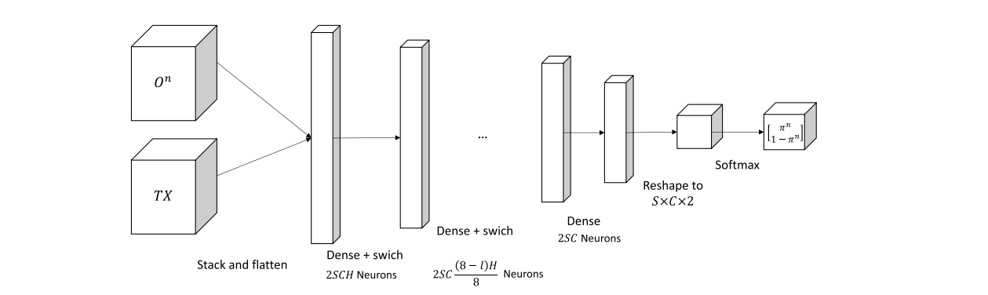
Multi-Agent Deep Learning for Multi-Channel Access in Slotted Wireless Networks [4] (cont.)
Architecture of Deep Neural Network:
The neural network is comprised of 8 fully connected layers with a switch activation function on each layer with the exception of softmax activation function in the last layer. The model is trained using online learning where sample are randomly selected from the buffer and the weights are optimized using RMSProp optimizer.

Slide 10
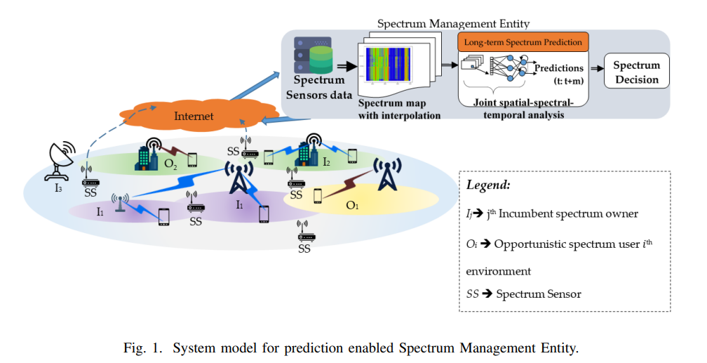
Convolutional LSTM-based Long-Term Spectrum Prediction for Dynamic Spectrum Access [5]
Problem Domain: Dynamic Spectrum Access (DSA), Cognitive Radio (CR)
Problem Statement: Alleviate inefficient use of radio spectrum by relying on presumed knowledge of the spectrum occupancy from sensing or predictions.

Slide 11
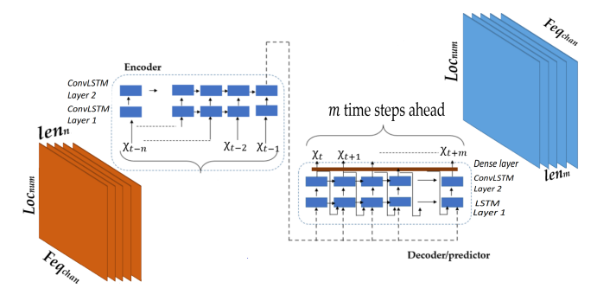
Convolutional LSTM-based Long-Term Spectrum Prediction for Dynamic Spectrum Access [5] (cont.)
Proposed Solution: Convolutional Long Short-Term Memory (ConvLSTM) for a long-termed temporal prediction that is trained to learn join spatial-spectral-temporal dependencies observed in spectrum usage.
Improvement: Stable prediction performance evaluate using 95% avg. Root Mean Square Error (RMSE) value at 0.07 deviation from the mean.
Architecture:

Slide 12
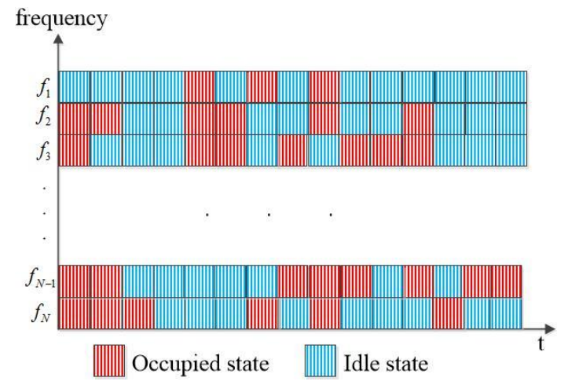
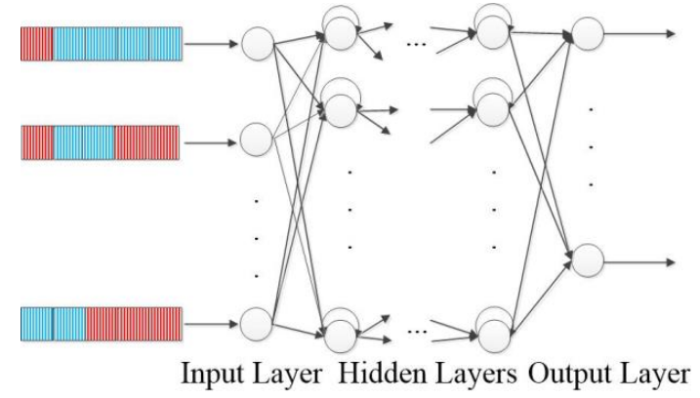
Spectrum Prediction via Long Short Term Memory [6]
[Problem Domain, Challenges, Previous Models are same as previous model]
Proposed Solution: Prediction model composed of Long Short Time Memory (LSTM) layers trained using supervised learning.
Improvements: 4% increase in prediction performance than wrong channel states
Mechanism and Architecture of LSTM Network:

Slide 13
Deep learning-based spectrum prediction collision avoidance for hybrid wireless environments [7]
Problem Domain: Wireless Spectrum Resource Scarcity, Multi-Technology Challenges
Existing Technology: Collision avoidance technique are used to deal with this problem. They are:
Random-backoff when Spectrum Collision is detected
Assume knowledge about other nodes’ spectrum occupation
Limitation of Existing Technology: Increased Collision in Dense Multi-Technology Environments
Previous Solutions:
Regular Multiple Frequence TDMA (MF-TDMA)
Exponentially Weighted Moving Average (EWMA) Scheduler
Proposed Solution: Spectrum Prediction Collision Avoidance (SPCA)
Improvement: Collision rate reduced by 4.5 times and 2.5 times compared to MF-TDMA and EWMA Scheduler respectively in Dense Multi-Technology Environments

Slide 14
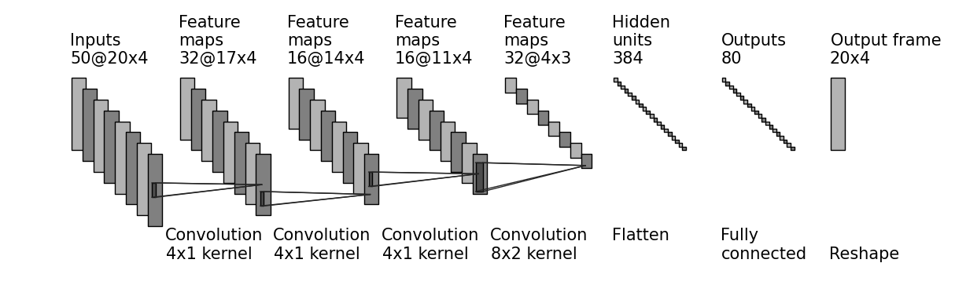
Deep learning-based spectrum prediction collision avoidance for hybrid wireless environments [7] (cont.)
Mechanism: Predict behaviour of surrounding networks using Supervised Deep Learning and adapt behaviour to maximize overall throughput of Multiple Frequency TDMA network and surrounding networks. Convolutional Neural Network (CNN) is used to predict spectrum usage of neighbors.
Architecture of CNN: A pre-trained CNN predictor unit is used to help the MF-TDMA scheduler to increase the combined throughput of the network.

Slide 15
Motivation
The dimensions of spectrum usage pattern are complex due to many factors such as diverse user requirements. radio propagation environment, user mobility etc.
Increasing number of connected wireless devices and their hunger for band spectrum.
Promise of transformer architecture to crack almost every fields including but not limited to vision, natural language, speech etc.

Slide 16
Objectives
Formulate a new short-term spectrum prediction scheme with Transformer-based DL network to capture the spectral features and temporal dependencies of the spectrum data.
Forecast single state of future spectrum data using previously observed spectrum measurement
Evaluate the proposed architecture with real environment spectrum data and assess the short-term prediction accuracy in different spectrum bands.
Achieve high accuracy in predicting realistic and complicated scenarios with multiple users and simultaneous transmission.

Slide 17
Proposed Method
Spectrum measurement data will be taken in the form of received signal power in dBm spectrum sensors. Then a spatially interpolated spectrum map will be created using Inverse Distance Weighting method. Therefore, the spectrum data becomes a function of frequency, time and space. We refer to this as input state embedding and a shifted version of this as output state embedding. Both of these embeddings, along with their positional encodings will be fed into the transformer layer. After a fair amount of supervised training our model will be able to output the probability of unforeseen spectrum data i.e. a function of frequency, time and space that was not given in the training data.

Slide 18
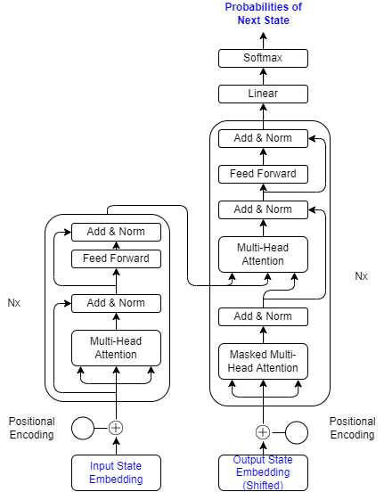
Architecture
Figure: Model Architecture

Slide 19
References
R. Mennes, M. Camelo, M. Claeys and S. Latré, "A neural-network-based MF-TDMA MAC scheduler for collaborative wireless networks," 2018 IEEE Wireless Communications and Networking Conference (WCNC), 2018, pp. 1-6, doi: 10.1109/WCNC.2018.8377044.
X. Li, Z. Liu, G. Chen, Y. Xu and T. Song, "Deep Learning for Spectrum Prediction From Spatial–Temporal–Spectral Data," in IEEE Communications Letters, vol. 25, no. 4, pp. 1216-1220, April 2021, doi: 10.1109/LCOMM.2020.3045205.
Y. Zhang, J. Hou, V. Towhidlou and M. R. Shikh-Bahaei, "A Neural Network Prediction-Based Adaptive Mode Selection Scheme in Full-Duplex Cognitive Networks," in IEEE Transactions on Cognitive Communications and Networking, vol. 5, no. 3, pp. 540-553, Sept. 2019, doi: 10.1109/TCCN.2019.2911005.
R. Mennes, F. A. P. De Figueiredo and S. Latré, "Multi-Agent Deep Learning for Multi-Channel Access in Slotted Wireless Networks," in IEEE Access, vol. 8, pp. 95032-95045, 2020, doi: 10.1109/ACCESS.2020.2995456.
B. S. Shawel, D. H. Woldegebreal and S. Pollin, "Convolutional LSTM-based Long-Term Spectrum Prediction for Dynamic Spectrum Access," 2019 27th European Signal Processing Conference (EUSIPCO), 2019, pp. 1-5, doi: 10.23919/EUSIPCO.2019.8902956.
L. Yu, J. Chen and G. Ding, "Spectrum prediction via long short term memory," 2017 3rd IEEE International Conference on Computer and Communications (ICCC), 2017, pp. 643-647, doi: 10.1109/CompComm.2017.8322623.
R. Mennes, M. Claeys, F. A. P. De Figueiredo, I. Jabandžić, I. Moerman and S. Latré, "Deep Learning-Based Spectrum Prediction Collision Avoidance for Hybrid Wireless Environments," in IEEE Access, vol. 7, pp. 45818-45830, 2019, doi: 10.1109/ACCESS.2019.2909398.

